Slide 1
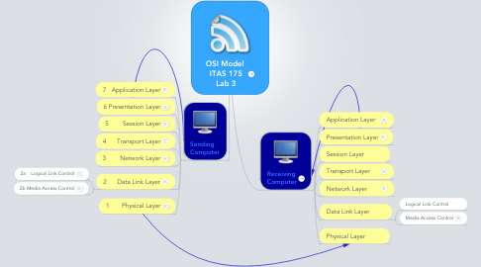
OSI MODEL
7 layer Describe

Slide 2
7 LAYERS
7. Application Layer
The application layer is used by end-user software such as web browsers and email clients.
6. Presentation Layer
The presentation layer prepares data for the application layer. It defines how two devices should encode, encrypt, and compress data so it is received correctly on the other end.

Slide 3
5. Session Layer
The session layer creates communication channels, called sessions, between devices. It is responsible for opening sessions, ensuring they remain open and functional while data is being transferred, and closing them when communication ends.
4. Transport Layer
The transport layer takes data transferred in the session layer and breaks it into “segments” on the transmitting end.

Slide 4
3. Network Layer
The network layer has two main functions. One is breaking up segments into network packets, and reassembling the packets on the receiving end. The other is routing packets by discovering the best path across a physical network.
2. Data Link Layer
The data link layer establishes and terminates a connection between two physically-connected nodes on a network.
1. Physical Layer
The physical layer is responsible for the physical cable or wireless connection between network nodes

Slide 5
THANK YOU

